Slide 1
Architecture
Nimesh Subedi
Kwok Moon Ho
Mario da Silva
Justen Neeley
Lucas Freitas
Heather Hanks

Slide 2
Architecture
Four Subtopic of Architecture:
Bottom Up
Top Down
Structure Charts
Layering

Slide 3
Bottom Up
Main Idea: A sort of 'Seed' model. Start small, but eventually grow in complexity. Start from the base elements and then grow from there.
Base Elements Specified First
Link Together to Form Larger Subsystems
Keep Linking Until Top Level System is Formed

Slide 4
Bottom Up - Advantages
Benefits are realized in the early phase.
Implements password management for large number of users.
Organization broadens identity management skills and understanding during the first phase.

Slide 5
Bottom Up - Disadvantages
Organizational structure may have to be changed in later phases.
Strategy is driven by existing infrastructure instead of business processes.

Slide 6
Top Down
Main idea: Start complex, with the big picture, but then break things down until there is only the base elements left.
Start Complex, but break down
Breaking Down of System (Reverse Engineer)
Overview Formulated
Subsystems then refined
Continues to base elements.

Slide 7
Top Down - Advantages
Focused use of resources.
First implementation becomes a showcase for the identity management solution.
Completed phases implements deeper and more mature implementation of identity management solution.

Slide 8
Top Down - Disadvantages
Limited Coverage in first phases.
Minimal percentage of user accounts are managed in the first phases.
The benefits of the solution will not be realized as quickly.
Implementation cost is likely to be higher.

Slide 9
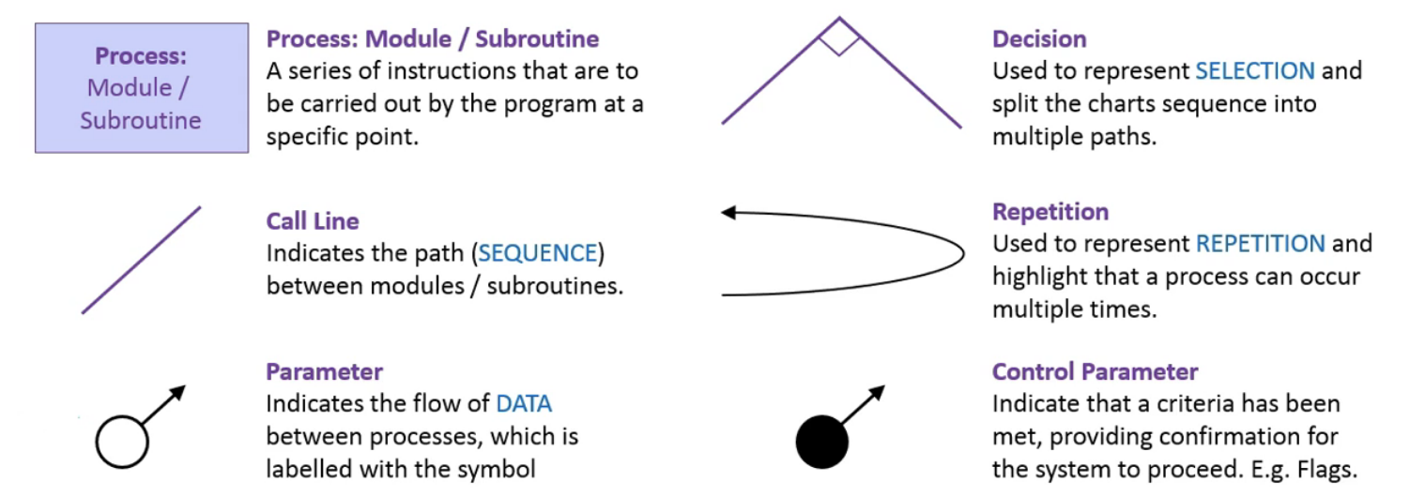
Structure Charts
Structure charts are used to graphically model the hierarchy of process within a system.

Slide 10
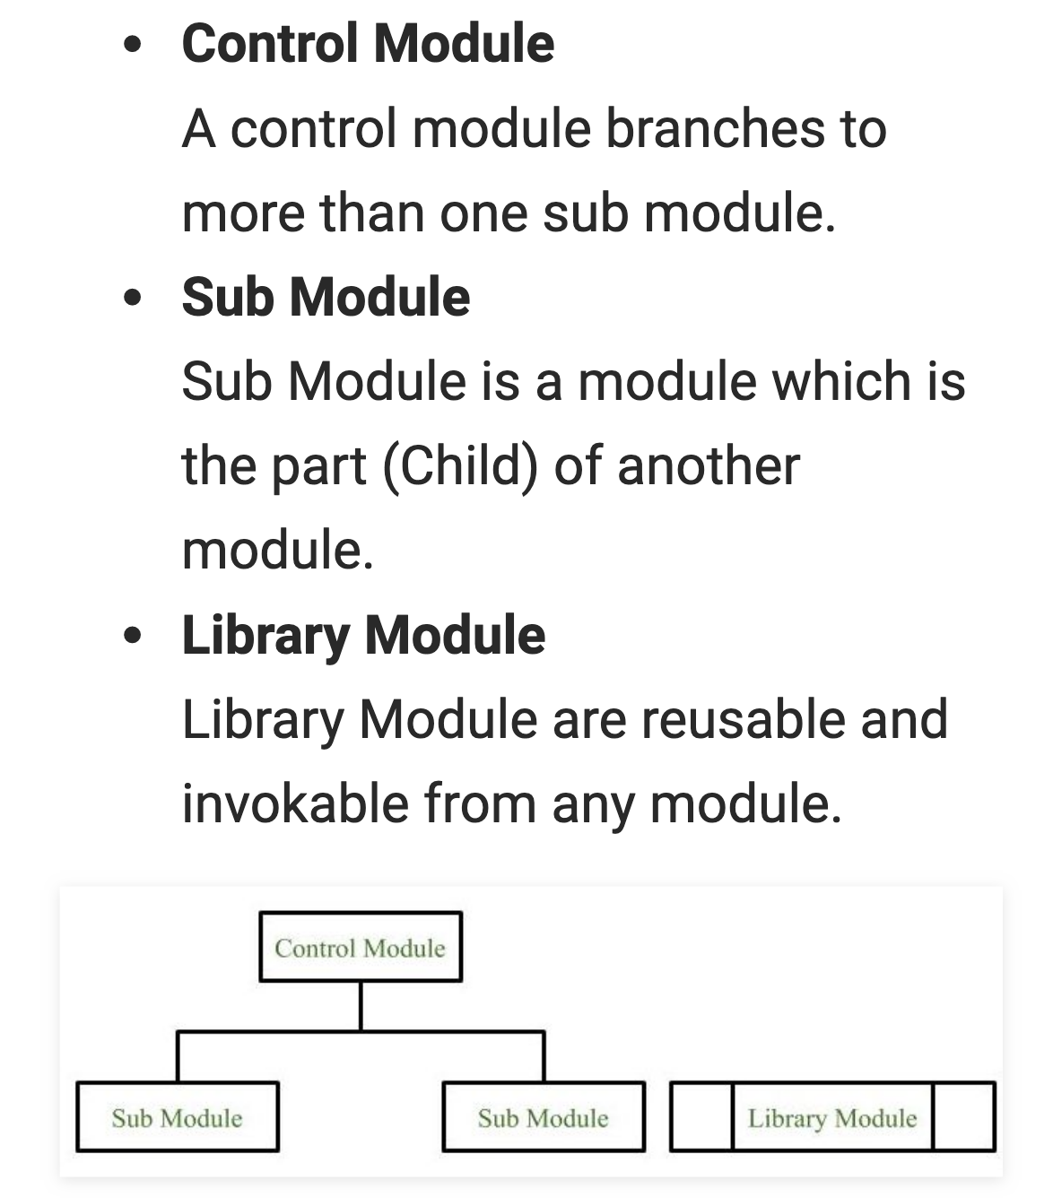

Slide 11
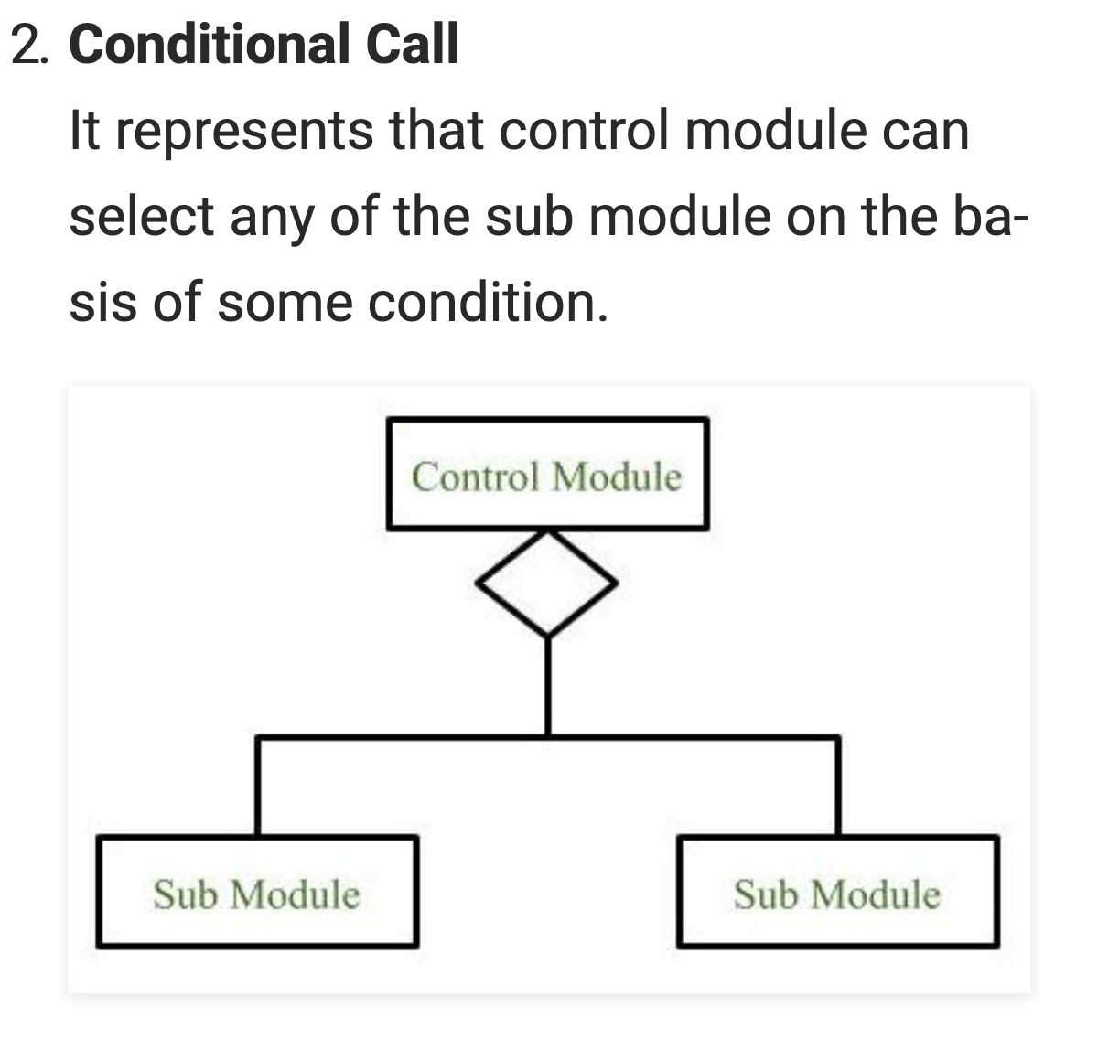

Slide 12
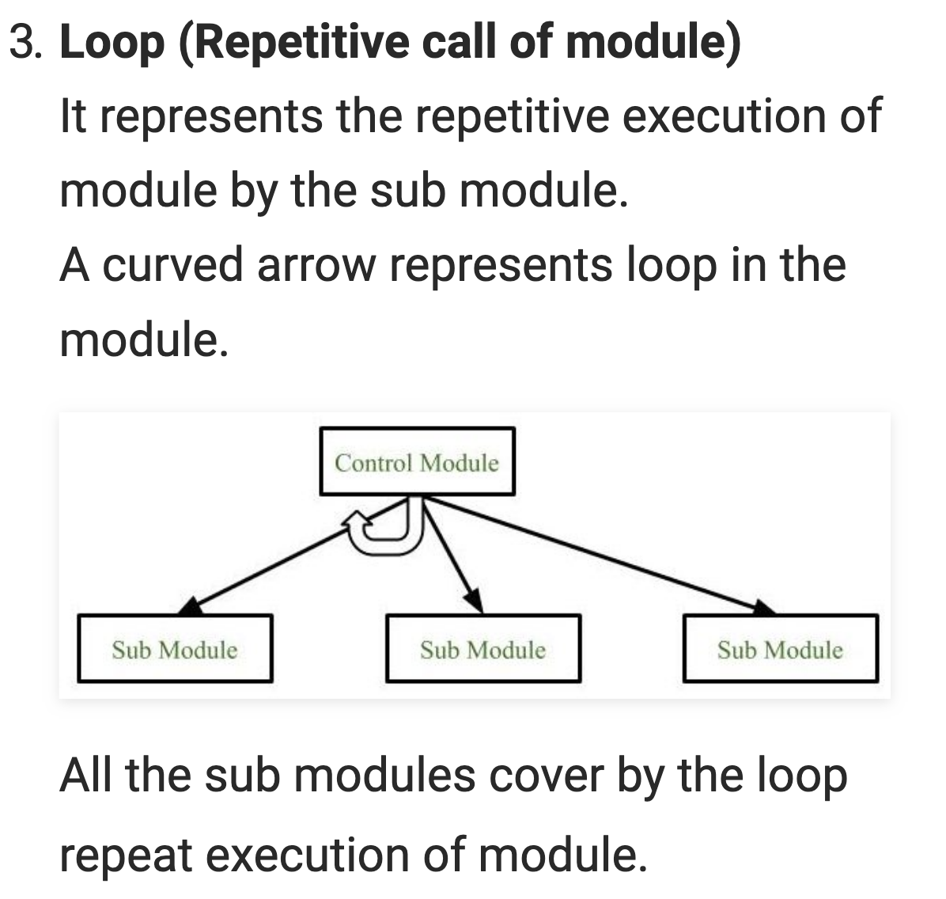

Slide 13
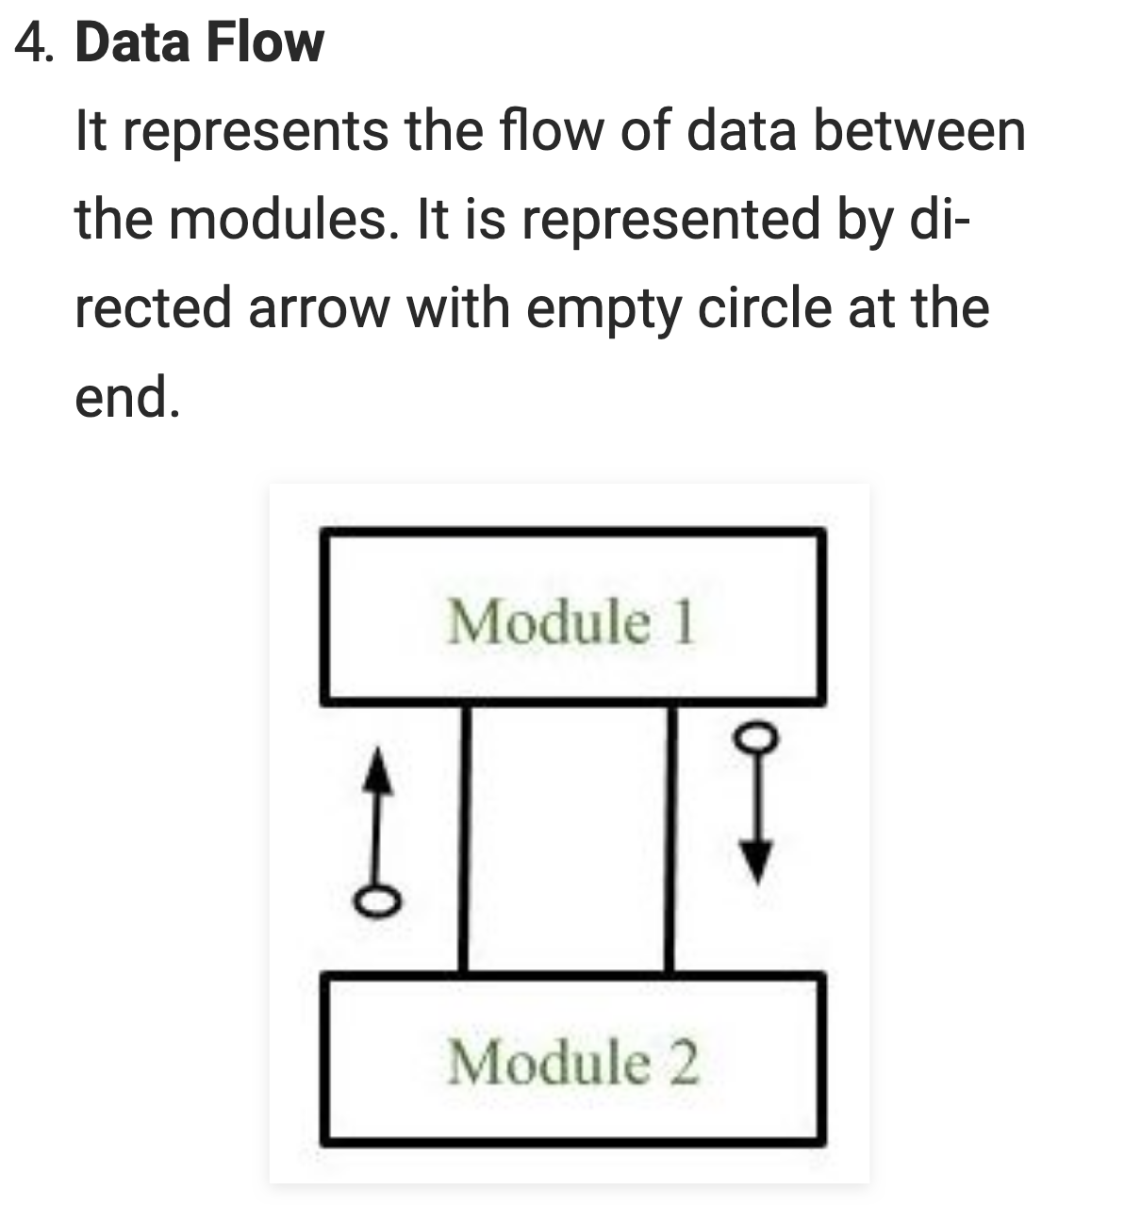

Slide 14
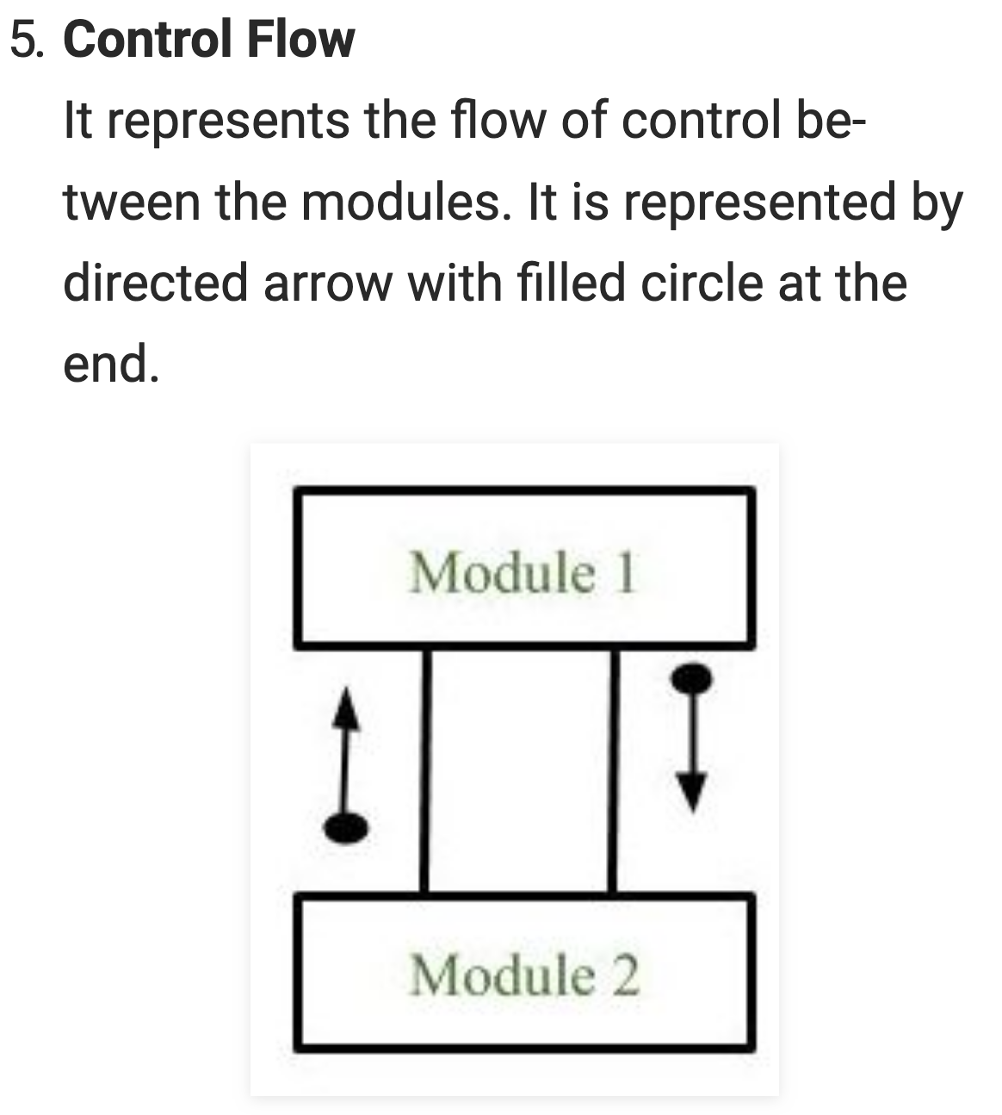

Slide 15
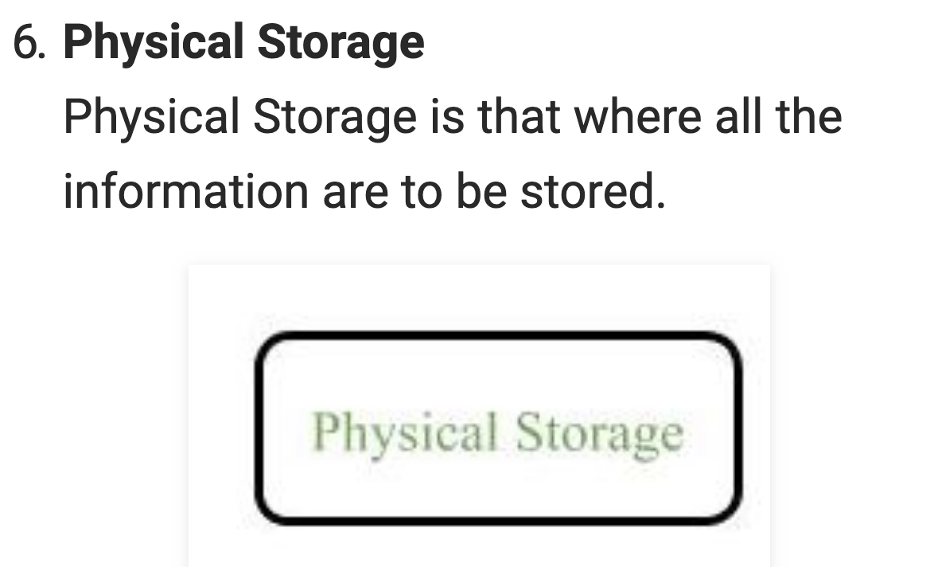

Slide 16
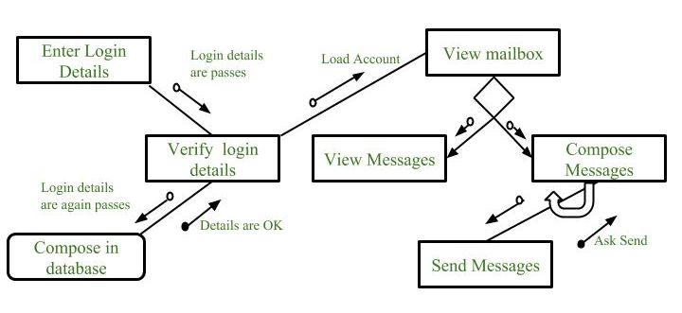

Slide 17
Layering
Also Known as N-tier or multitier architecture.

Slide 18
Layers
3 layers
Presentation: responsible for handling all user interface and browser communication logic,
Business: execute specific business rules associated with the request
Data: display information on a screen in particular format.

Slide 19
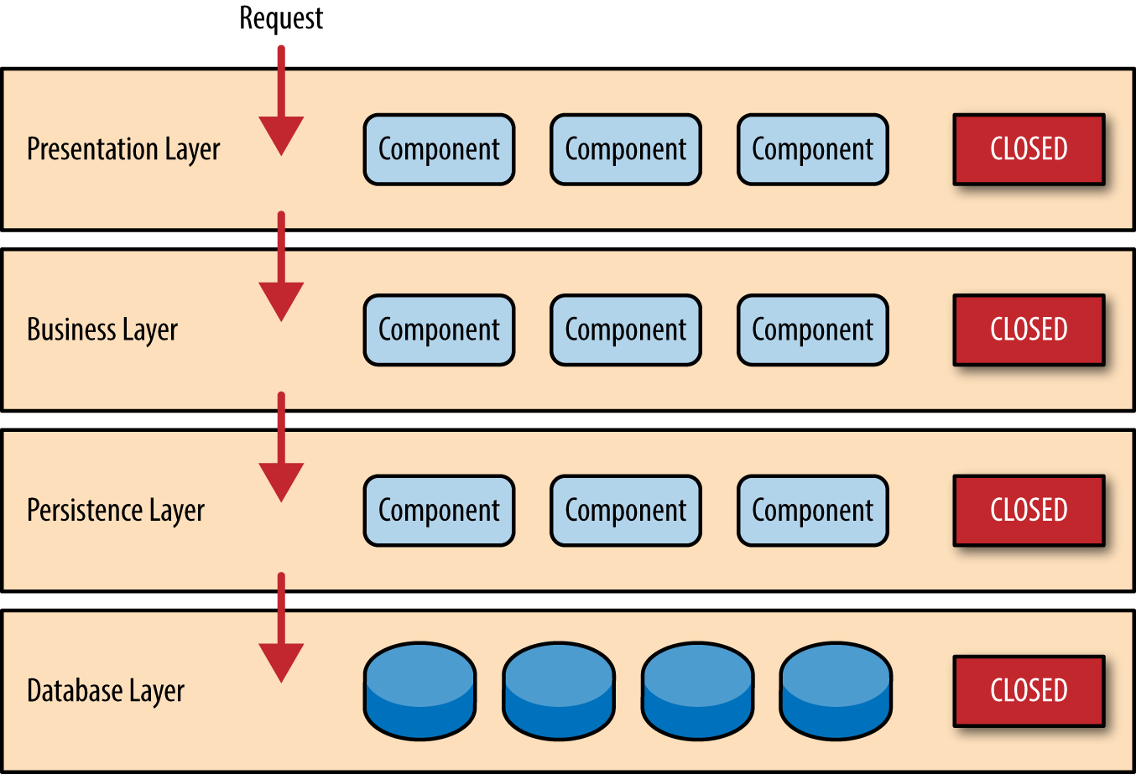
Closed Layer architecture

Slide 20
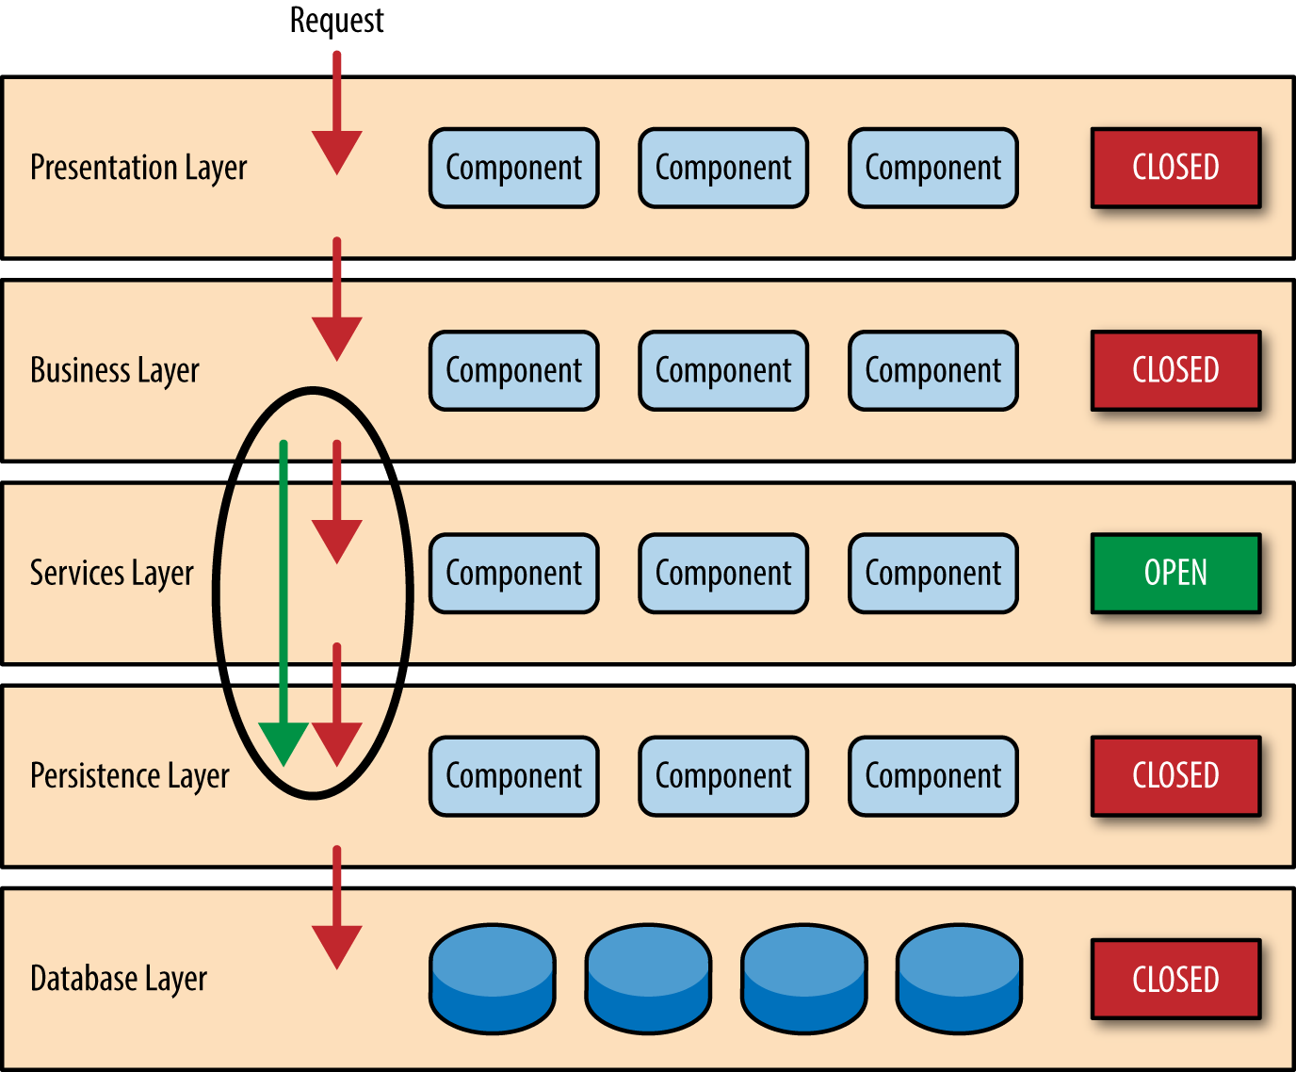
Open layer Architecture

Slide 21
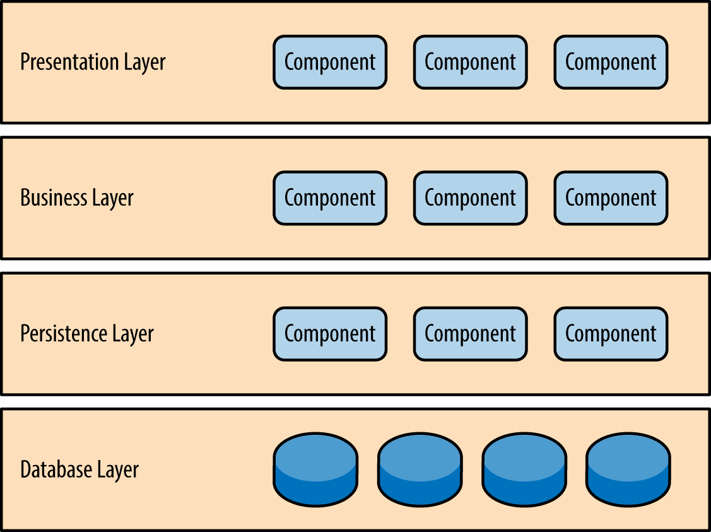
Example

Slide 22
Key Concepts
Physical tiers
Logical layers
Layers of Isolation
Notes:
Changes are made to a single layer, without affecting any other layers Key Concepts
Notice in Figure 1-2 that each of the layers in the architecture is marked as being closed. This is a very important concept in the layered architecture pattern. A closed layer means that as a request moves from layer to layer, it must go through the layer right below it to get to the next layer below that one. For example, a request originating from the presentation layer must first go through the business layer and then to the persistence layer before finally hitting the database layer.
￼
Figure 1-2. Closed layers and request access
So why not allow the presentation layer direct access to either the persistence layer or database layer? After all, direct database access from the presentation layer is much faster than going through a bunch of unnecessary layers just to retrieve or save database information. The answer to this question lies in a key concept known as layers of isolation.
The layers of isolation concept means that changes made in one layer of the architecture generally don’t impact or affect components in other layers: the change is isolated to the components within that layer, and possibly another associated layer (such as a persistence layer containing SQL). If you allow the presentation layer direct access to the persistence layer, then changes made to SQL within the persistence layer would impact both the business layer and the presentation layer, thereby producing a very tightly coupled application with lots of interdependencies between components. This type of architecture then becomes very hard and expensive to change.

Slide 23
Advantages
Ease of Development
Testability
Portability
Multi-environment

Slide 24
Disadvantages
Monoliths
Sinkholes
Performance
Large systems Security
Notes:
Monoliths: this architecture tends toward creating large systems that do everything, rather than modular systems
Sinkholes: Layers that simply pass a request through without any operations
Scalability: Does not welcome change or growth, tends toward large, static systems
Performance: passing through multiple layers, especially if multiple servers are involved, can significantly decrease performance.

Slide 25
Best Used for:
IaaS(infrastructure as a Service
Simple web applications

Slide 26
Sources
Structure Chart:
https://www.youtube.com/watch?v=QN2bjNplGlQ
https://www.geeksforgeeks.org/software-engineering-structure-charts/
https://en.wikipedia.org/wiki/Structure_chart
https://www.w3computing.com/systemsanalysis/using-structure-charts-design-modular-systems/

Slide 27
Sources
Layers:
1. Docs.microsoft.com. (2019). Three-Layered Services Application. [online] Available at: https://docs.microsoft.com/en-us/previous-versions/msp-n-p/ff648105%28v%3dpandp.10%29 [Accessed 3 Jun. 2019].
2. Richards, M. (2015). Software architecture patterns.
3. Fisma.fi. (2019). [online] Available at: http://www.fisma.fi/wp-content/uploads/2014/06/Guideline_for_Multilayer_Architecture_FiSMA11_06.pdf [Accessed 3 Jun. 2019].
4. Wasson, Mike. “N-Tier Architecture Style - Azure Application Architecture Guide.” Azure Application Architecture Guide | Microsoft Docs, 2018, docs.microsoft.com/en-us/azure/architecture/guide/architecture-styles/n-tier.

Slide 28
Sources
Top-Down, Bottom-up:
1. Top-down and Bottom-up Design
https://en.wikipedia.org/wiki/Top-down_and_bottom-up_design
2. https://publib.boulder.ibm.com/tividd/td/ITIM/SC32-1708-00/en_US/HTML/im460_plan76.htm
3. Top Down Vs Bottom Up Architecture
Craig Skipsey-Craig Skipsey - http://www.gwts.com.au/blog/entry/top-down-vs-bottom-up-architecture
4. How and Why Does Top-down Programming Work? - Dzone Devops
Ashley Kornee - https://dzone.com/articles/how-does-top-down-programming-work

Slide 29
ANY QUESTIONS ?

